Slide 1


Designing a Lexical Analyzer
Tokenizing a simple language with clarity and rigor
Notes:
Image source: AI-generated

Slide 2

Introduction to Lexical Analysis
Notes:
Role of a Lexical Analyzer in a Compiler, Overview of Tokens and Source Code Processing

Slide 3
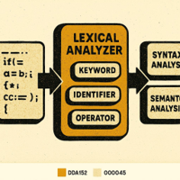
Role of a Lexical Analyzer in a Compiler
Tokenization and Categorization
Reads source code and converts character streams into tokens like keywords, identifiers, literals, and operators.
Early Error Detection
Catches illegal characters and malformed tokens before syntax analysis, improving accuracy.
Performance Impact
Efficient scanning accelerates the compiler pipeline and simplifies downstream parsing.
Notes:
The lexical analyzer is the first phase in a compiler pipeline, responsible for reading the source code and converting it into a sequence of tokens. It simplifies syntax analysis by categorizing input characters into meaningful groups such as keywords, identifiers, literals, and operators. Efficient lexical analysis directly impacts the overall compiler speed and accuracy, as it catches illegal characters and malformed tokens early. Image source: AI-generated

Slide 4
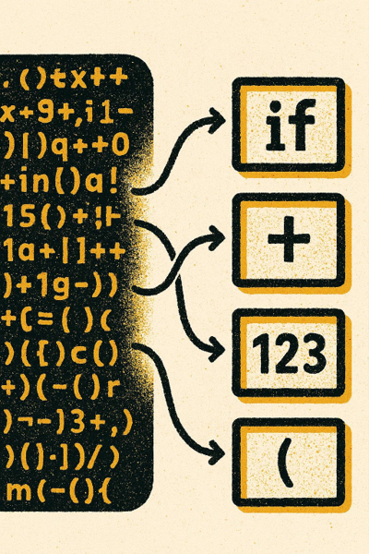
Overview of Tokens and Source Code Processing
1
Token Basics
Tokens are the smallest meaningful units: keywords, operators, identifiers, literals, and punctuation used by parsers.
2
Scanning and Recognition
The lexer scans characters, detects token boundaries, and classifies each token according to language rules.
3
Enabling Parsing
Tokenization abstracts raw text into structured units, reducing complexity so grammar rules can be applied efficiently.
Notes:
Tokens represent the smallest units of meaning in the source code, such as keywords like 'if', operators like '+', or literals like '123'. The source code processing involves scanning the character stream, recognizing token boundaries, and classifying token types. Tokenization reduces complexity by abstracting raw source into manageable components for parsing, enabling subsequent stages to apply grammar rules efficiently. Image source: AI-generated

Slide 5
Managing the Source Buffer
Notes:
Representing Source Code as a Buffer of Characters, Efficient Traversal and Storage

Slide 6
Representing Source Code as a Buffer of Characters
Detailed format clarifies buffer structure and memory considerations
Why use a buffer
Source code stored as a contiguous character buffer enables fast sequential reading and constant‑time indexing. Lexers and parsers often advance a read index one character at a time, peek ahead without copying, and slice substrings by recording start and end positions. This design minimizes overhead because characters remain in place and algorithms operate on indices instead of moving data. It also simplifies EOF detection, backtracking, and error reporting by tying diagnostics directly to offsets. In practice, a flat buffer aligns well with CPU caches and common I/O routines, delivering predictable performance across small scripts and very large files alike.
Sequential access mechanics
A lexer typically maintains an index for the current position, with helpers to advance, retreat, and peek. Advancing increments the index; peeking reads without changing it; slicing captures token text by referencing the same underlying memory. Common helpers also normalize newlines, handle BOMs, and merge surrogate pairs or decode UTF‑8 sequences as needed. Because operations are index‑based, backtracking is inexpensive and lookahead for multi‑character tokens (e.g., operators) remains efficient. This predictable, linear progression reduces branching and favors tight loops that the compiler can optimize.
Memory considerations
Use an immutable buffer when possible to avoid accidental mutations and enable safe sharing across threads or components. For large files, favor memory‑mapped I/O or chunked loading to reduce allocation and copy costs, while keeping a logical contiguous view via indices. Store positions as 32‑ or 64‑bit integers depending on maximum file sizes, and map offsets to line/column lazily to avoid per‑character bookkeeping. If text is UTF‑8, keep offsets in bytes and compute code‑point indices only when needed. These choices balance memory footprint, correctness with Unicode, and consistent high throughput.
Notes:
Source code is typically stored as a contiguous buffer (array) of characters to allow efficient sequential access. This buffer facilitates easy indexing and management of read positions. Using a buffer supports fast look-up and character retrieval, essential for high-performance lexing, especially for large source files.

Slide 7
Efficient Traversal and Storage
Maintain indices for current, lookahead, and token start to avoid copying and backtracking. These can then be used for error handling.
Source Buffer
x
=
5
;
i
f
(
Current
Lookahead
Start of token
In our code we will use the following names:
source – source code buffer
position – current position in the buffer
line – current line number
column – current column number in the line
Notes:
Efficient traversal involves maintaining pointers or indices tracking the current character, lookahead, and start of tokens, minimizing unnecessary copying or backtracking. Using ring buffers or double buffering can help reduce overhead. Proper storage mechanisms, such as storing lexemes in temporary buffers, ensure speed without excessive memory usage, balancing runtime performance with space complexity. Image source: AI-generated

Slide 8
Core Navigation Functions
Notes:
Implementing the Peek Function to Look Ahead, Using Advance to Consume Characters, Detecting End of Source with isAtEnd

Slide 9

Checking for end of buffer
Purpose
Ensure we have not hit the end of our buffer
How it helps
Prevents exceptions and tells us when to stop our lexer.
Pseudocode
function isAtEnd() {
return position >= source.length
}
Notes:
The 'peek' function allows the lexer to inspect the next unconsumed character without advancing the current position. This lookahead capability is crucial for handling multi-character tokens or deciding when token boundaries are reached, such as distinguishing '=' versus '=='. It supports conditional parsing decisions without losing buffer state. Image source: AI-generated

Slide 10
Implementing the Advance Function to consume characters
Purpose
Moves the position forward by one and returns the character that was at the current position.
How it helps
Updates the internal state as well as the appropriate line and position variables
Pseudocode
function advance() {
if (isAtEnd())
return ‘\0’;
return input[position + 1];
}
Notes:
The 'peek' function allows the lexer to inspect the next unconsumed character without advancing the current position. This lookahead capability is crucial for handling multi-character tokens or deciding when token boundaries are reached, such as distinguishing '=' versus '=='. It supports conditional parsing decisions without losing buffer state. Image source: AI-generated

Slide 11
Implementing the Peek Function to Look Ahead
Purpose
Look ahead without advancing to handle multi-character tokens and safe boundary checks.
How it helps
Differentiates '=' vs '==' and similar cases without losing the current position.
Pseudocode
function peek() {
if (isAtEnd())
return ‘\0;l
return input[position + 1];
}
Notes:
The 'peek' function allows the lexer to inspect the next unconsumed character without advancing the current position. This lookahead capability is crucial for handling multi-character tokens or deciding when token boundaries are reached, such as distinguishing '=' versus '=='. It supports conditional parsing decisions without losing buffer state. Image source: AI-generated

Slide 12
Handling Whitespace and Keywords
Notes:
Skipping Irrelevant Whitespace, Checking and Identifying Language Keywords

Slide 13
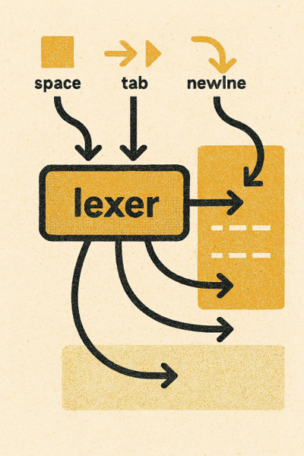
Skipping Irrelevant Whitespace
1. Non-significant whitespace
Spaces, tabs, and newlines are usually skipped to streamline the token stream and reduce parser work.
2. Comments
Comments are skipped in the lexer
3. Tracking lines and errors
Lexers still count newlines and positions so diagnostics remain accurate even when whitespace is ignored.
Notes:
Whitespace characters such as spaces, tabs, and newlines are generally non-significant for token definitions and are skipped by the lexer to streamline the token stream. Effective whitespace handling improves performance and reduces parsing complexity. Certain whitespace may be significant for line counting or error reporting, so lexical analyzers must track it carefully. Image source: AI-generated

Slide 14



Checking and Identifying Language Keywords
If/Case
Simplest approach but requires more code maintenance as the language grows
Map
Offers constant-time lookup and new keywords can be added easily
Notes:
After identifiers are extracted, the lexer consults a keyword table to distinguish language reserved words from user-defined names. Implementing this lookup via hash tables or tries allows fast keyword identification. Accurate keyword detection is critical to parsing correctness as keywords have special syntactic and semantic roles. Image source: AI-generated

Slide 15
Reading and Classifying Tokens
Notes:
Reading Numeric Literals with ReadNumber, Extracting Identifiers with ReadIdentifier, Parsing String Literals Using ReadString

Slide 16

Reading Numeric Literals with ReadNumber
Digit Sequence
The function reads consecutive digits, forming the base of the number. Example: '123’. It stops when it encounters a non numeric character
Notes:
The ReadNumber function processes sequences of digits to form integer or floating-point literals. It handles optional components like decimal points and exponents. Proper recognition ensures numeric constants are accurately tokenized, supporting downstream semantic checks and evaluations. Edge cases like leading zeros or malformed numbers must be addressed. Image source: AI-generated

Slide 17
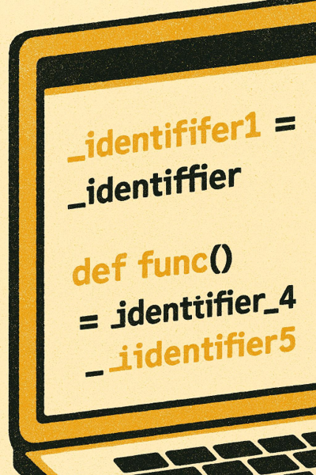
Extracting Identifiers with ReadIdentifier
1. Start with letter or underscore
Begin an identifier only if the first character is alphabetic (A–Z, a–z) or an underscore (_).
2. Continue with alphanumerics/underscores
Accumulate subsequent characters only if they are letters, digits (0–9), or underscores.
3. Stop on invalid characters
Terminate the token when encountering whitespace, punctuation, or any non‑identifier character to keep lexemes clean.
4. Enable keyword lookup
After collection, compare the lexeme against a reserved keyword table to classify tokens accurately.
Notes:
ReadIdentifier gathers sequences starting with an alphabetic character or underscore, followed by alphanumerics or underscores. This function collects lexemes for variable names, function names, and other user-defined symbols. It must ensure tokens do not include invalid characters and allow proper keyword lookup subsequently. Image source: AI-generated

Slide 18

Parsing String Literals Using ReadString
Escape Handling
Properly interprets sequences like newline, tab, quote, and backslash within quoted text.
Exact Capture
Preserves the string exactly as authored so the lexer reflects source intent.
Error Detection
Identifies unterminated strings and malformed escapes to ensure compile-time correctness.
Multi‑line Support
Handles multi-line literals when permitted by the language grammar.
Notes:
ReadString handles quoted text literals including escape sequences for characters such as newlines, tabs, and quotes themselves. It ensures the lexer captures strings exactly as in source code, including multi-line strings if supported. Error detection for unterminated strings is also essential for compiling correctness. Image source: AI-generated

Slide 19
Token Generation and Retrieval
Notes:
Defining the NextToken Function for Tokenization Flow, The Mechanics of CreateToken for Token Construction

Slide 20
NextToken: Tokenization Flow
01
Read next character
Pull the current rune/byte from input and advance the cursor.
02
Skip whitespace/comments
Consume spaces and comment blocks to align at the next lexeme.
03
Recognize token kind
Classify identifiers, literals, operators, or delimiters via DFA rules.
04
Emit next token
Return the token with span metadata; update state for continued scanning.
Notes:
NextToken coordinates the lexical analysis process by orchestrating character reading, whitespace skipping, token recognition, and returning the next token in sequence. It serves as the primary interface between the lexer and parser, ensuring continuous and accurate tokenization throughout source processing.

Slide 21
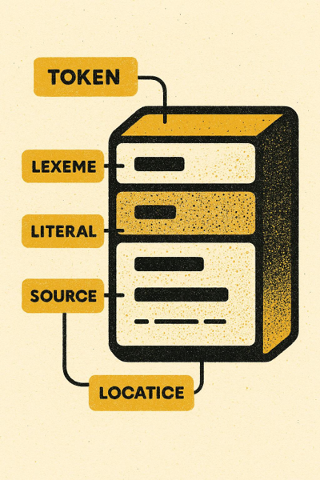
The Mechanics of CreateToken
Token object composition
CreateToken packages type, lexeme, literal value, and source location into a single, consistent structure.
Standardized format for phases
Uniform tokens enable predictable handling by parsing, analysis, and code generation stages.
Efficient data handling
Copy only necessary bytes for the lexeme and track start/end indices to avoid excess allocation.
Pseudocode construction guide
Outline a function that accepts type, slice bounds, and literal; returns a token with precise source location.
Notes:
CreateToken encapsulates information about token type, lexeme, literal value, and source location into a token object. This function standardizes token format, allowing uniform handling by later compiler phases. Efficient token creation involves copying only necessary data and maintaining accurate tracking of token boundaries. Image source: AI-generated

